Slide 1
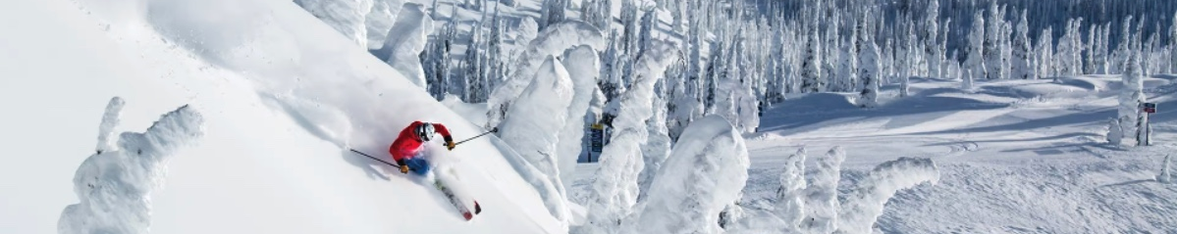
Whitefish Mountain Resort Ticket Price
Doosoo Yoon Data Science Team 2022.06.01

Slide 2
Problem Identification
How much can Whitefish Mountain Resort (WMR; renamed from Big Mountain Resort) increase lift ticket prices for weekdays and weekends in the upcoming season to maintain the service by covering the additional operating costs of $1,540,000 for the new chair lift?
Scope of solution:
Only consider the adult’s ticket price for weekends,
No difference of price between weekdays and weekends
No consideration of seasonal tickets, night skiing tickets
Data:
A single CSV file – 27 features for 330 resorts
Population and area data for the US states – Wikipedia

Slide 3
Problem Identification
How much can Whitefish Mountain Resort (WMR; renamed from Big Mountain Resort) increase lift ticket prices for weekdays and weekends in the upcoming season to maintain the service by covering the additional operating costs of $1,540,000 for the new chair lift?
Scope of solution:
Only consider the adult’s ticket price for weekends,
No difference of price between weekdays and weekends
No consideration of seasonal tickets, night skiing tickets
Data:
A single CSV file – 27 features for 330 resorts
Population and area data for the US states – Wikipedia

Slide 4
Recommendation
Our model suggests that
the current ticket price at WMR, $81, is underpriced, and there is a room to increase the price without risk,
the predicted ticket price is $95 → additional revenue: +$26M, which will cover the operating costs for the new chairlifts ($1.54M),
the ticket price can be further increased by adding the height of vertical drop: 150 feet lower down → additional revenue: +$3.5M

Slide 5
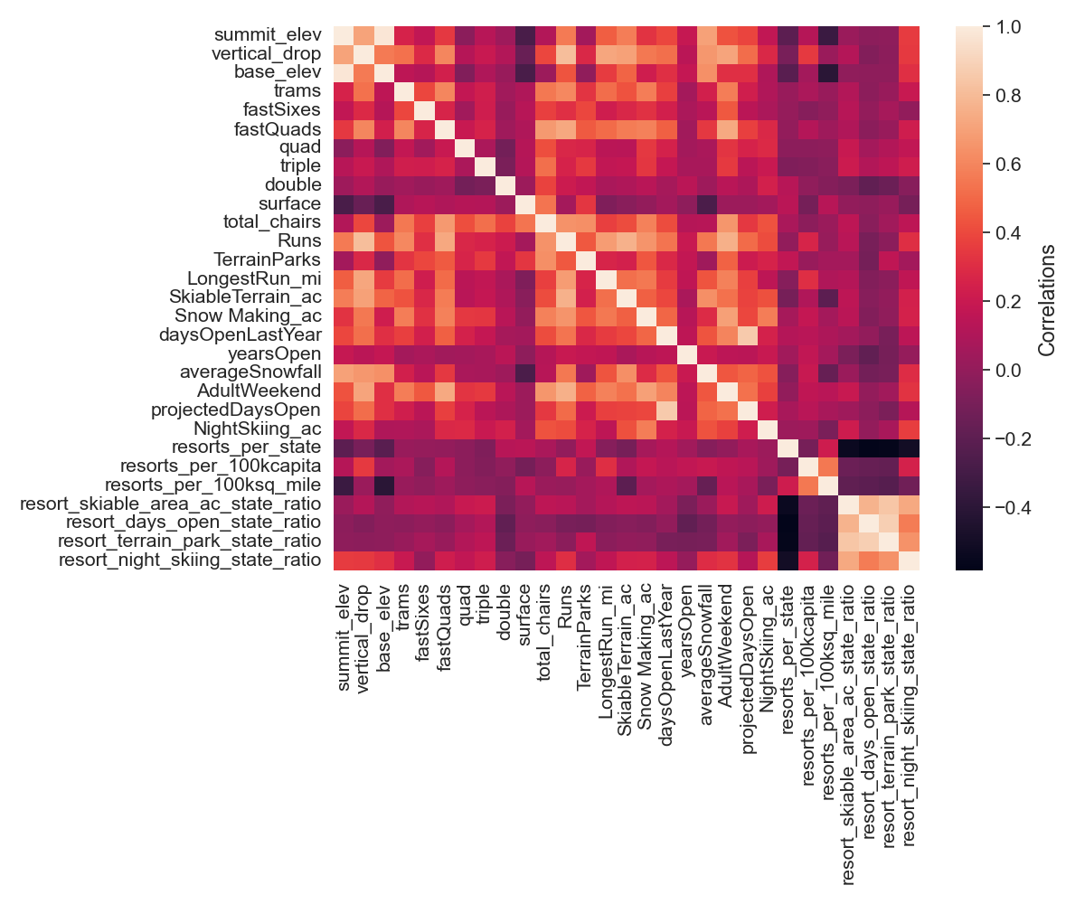
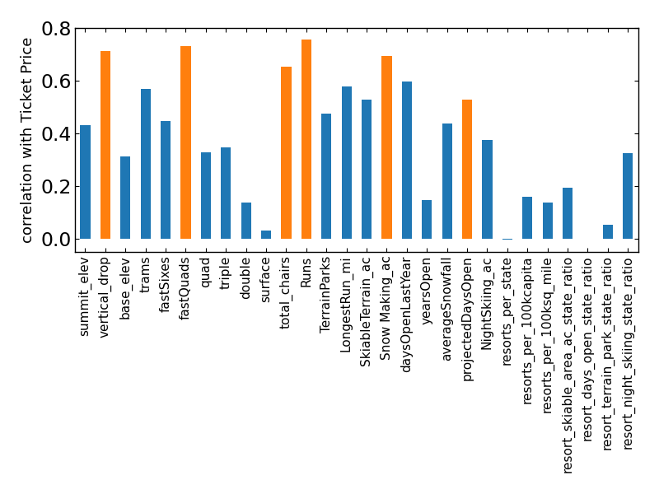
Modeling results
The correlation between features reveals that the ticket price may be influenced dominantly by
Vertical_drop, fastQuads, total_chairs, Runs, Snow Making_ac

Slide 6
Modeling results
The correlation between features reveals that the ticket price may be influenced dominantly by
Vertical_drop, fastQuads, total_chairs, Runs, Snow Making_ac

Slide 7
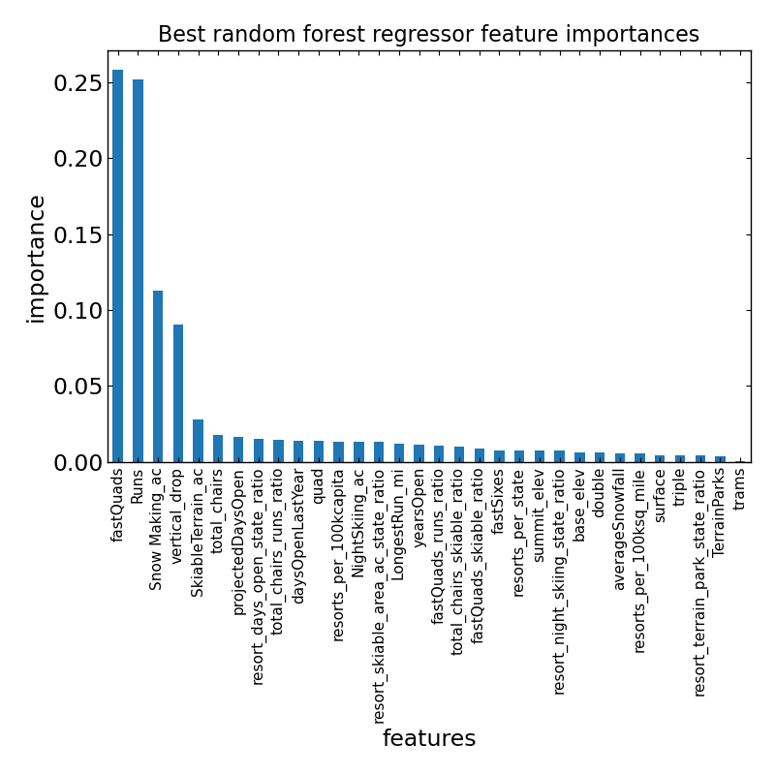
Modeling results
The importance in features from model is consistent with correlation analysis.

Slide 8
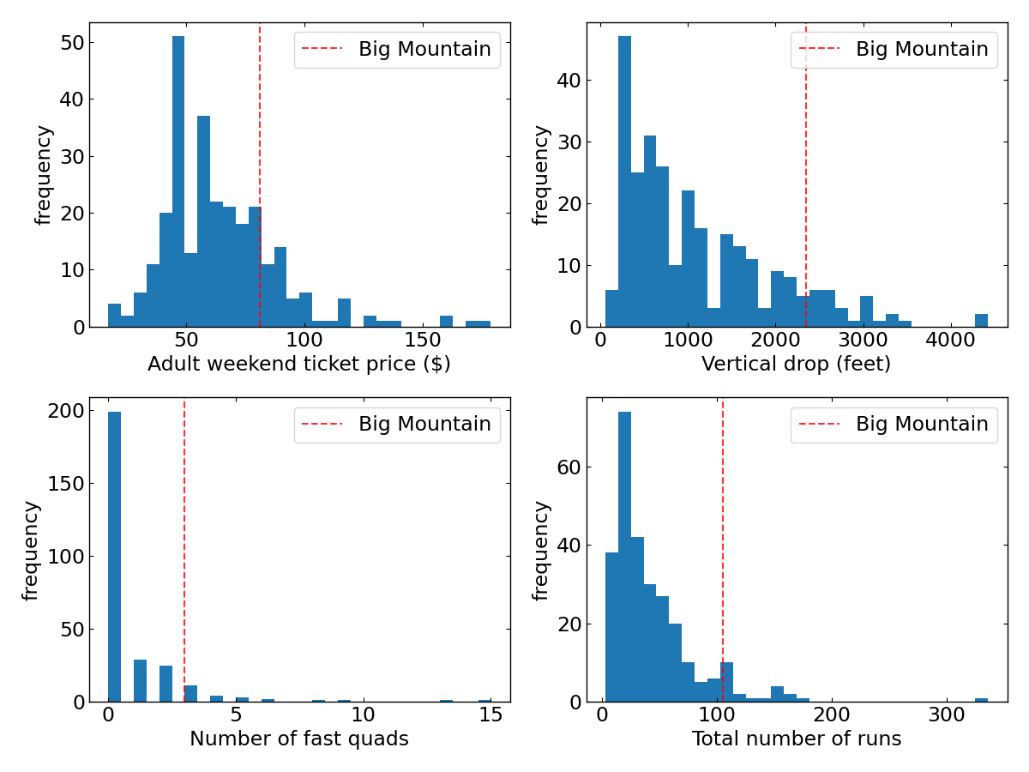
Where does WMR sit?
Distribution of resorts:
The ticket price at WMR is higher than the average price.
WMR is placed at high-level for most features

Slide 9
Summary and conclusion
After exploring the data for the resorts in the US and applying our model for the ticket, we conclude that
WMR’s current lift ticket is underpriced and there is a room that increases the ticket price up to $95, which is $14 higher than the current price,
if we assume that the number of visitors would be 350,000 (x 5 tickets for each visitor), the additional revenue would be $26M, which will cover the operating costs for the newly installed chairlift ($1.54M).
our best scenario, which was examined by our regression model, is that the ticket price can be further increased without risk if WMR increases the vertical drop by adding a run to a point 150 feet lower down.

Slide 10
Thank you !

